Slide 1
WANT TO GET
TRAINEESHIP
ABROAD?
EMAIL: Training@bixter.com
PHONE: +45 71 74 75 04
WEB: bixter.training
Notes:
Більше 40 тис. ферм

Slide 2
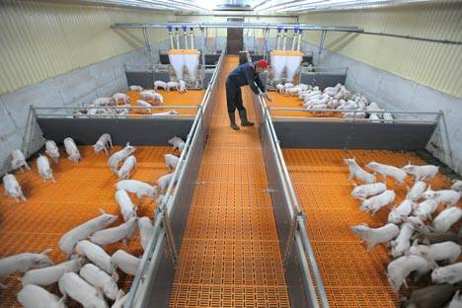
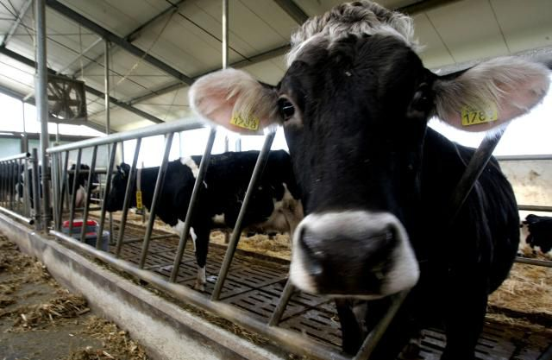
What we offer?
Bixter.training offers you international rural internship in Denmark, Norway, Germany or Switzerland
We have places in dairy productions, swine production, beef production, fur production, or poultries and greenhouses
If you have a EU-citizenship we can offer you a postgraduate program or an employment in animal production

Slide 3
3 main facts about us
We are Danish company that has agreements with more than 2000 employers and work WITHOUT ANY INTERMEDIARIES.
Over 13 years of work we
successfully have placed 7,000 interns
3. Our services for Citizens of European countries are free of charge.

Slide 4
Our Internships are in interest for:
Agronomists
Agrotechnologists (Animal Production and Plant Processing)
Veterinarians
Farmers
Other Agricultural Directions

Slide 5
Concedii
Work Conditions and Salary
 | Denmark | Germany | Norway
Salary Netto | 1200 | 1240 | 1320
Working hours | 37 | 40 | 37,5
Working weekends | Every second | Every second | Every second
Living conditions | Accommodation 200-300 € | Accommodation 150-250 € | Accommodation 250-300 €
Holiday | 5 weeks | 4 weeks | 4 weeks
Există 25 de zile de concediu plătit.
În fiecare lună 12,5% din salariu se transferă într-un cont special “FerieKonto” (“Cont pentru Concediu”).
Banii pot fi retrași din acest cont după sfârșitul stagiului, iar pentru 12 luni se pot obține aproximativ 1500 €.

Slide 6
Requirements (EU students)
Age over 18
Communicative level of English or German
Good physical condition
Requirements (non EU students)
Age 18 – 30 (35)
A2 level of English or German confirmed by certificate (TOEFL, IELTS)
Certain amount of ECTS points (depends on country)
Good physical condition
Ability to apply for trainee visa

Slide 7
How to apply
Visit our homepage bixter.training
More information about programs
Open positions
Application form

Slide 8
Thank you for your attention
EMAIL: Training@bixter.com
PHONE: +45 71 74 75 04
WEB: bixter.training

