Slide 1
License CAI
Art of International trade

Slide 2
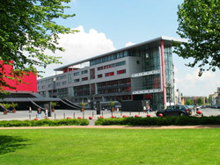
What is the license CAI?
CAI license ( Art of International trade ) is a professional license for a period of one academic year. This license is proposed to students of a partner university who want to end his bachelor in Valenciennes in France.

Slide 3
Classes and modules
Course to follow and validate in our partner university
Modules evaluated by the university of Valenciennes
Communications and Intercultural Studies
Marketing
International Marketing
Strategies of Communication
Financial Analysis
International Trade Methods
International Business Negotiations
International Operational Management
International Logistics
Business languages
Tutored group project
Internship abroad or export department of a French company (minimum 12 weeks)

Slide 4
Advantages of the license
to gain the necessary skills and competences for working in International marketing, management & strategic management, finance, business & economics on a European & international level
Discover a new country, culture
French and English diploma and the International diploma (DEMI or DICC)
Stay one year abroad
Three-month internship in a foreign company (professional experience)
International students in the same class

Slide 5
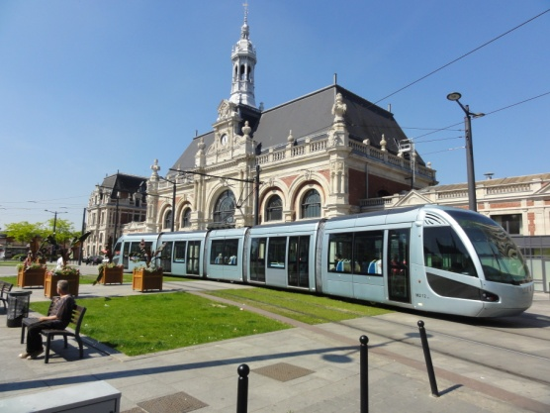
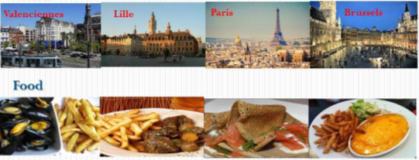
Advantages of the place
Valenciennes is very close to Lille, the capital of the “Nord-Pas-de-Calais”
Lille is at the center of many European capitals like Paris, London, Brussels, and Amsterdam
Valenciennes is a student and dynamic city

Slide 6
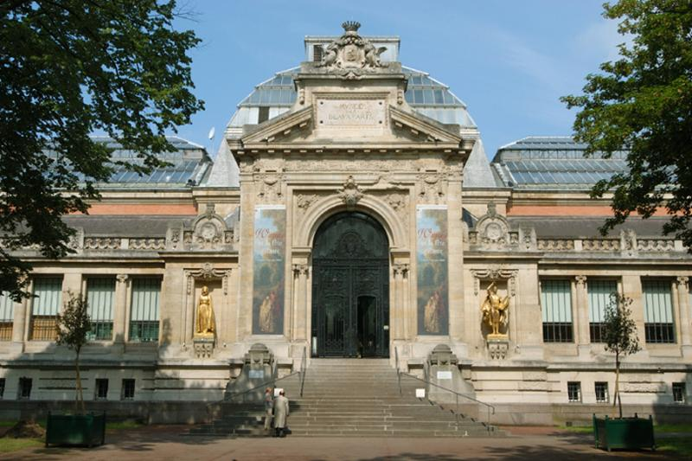
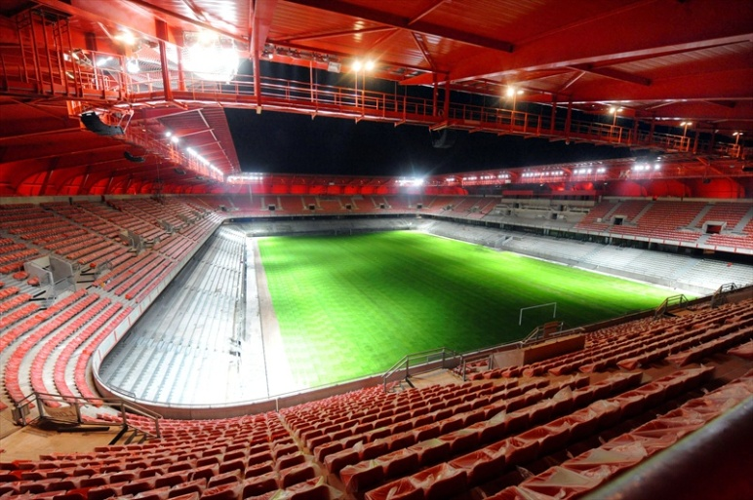
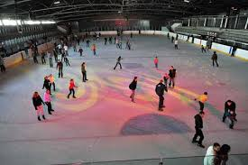
Valenciennes : a dynamic and lively local area
Culture : National Theater (The Phenix);
Media Center; Museum of fine arts
Sport : Nautical Center; Golf,
Tennis, Rowing, Nungesser Stadium
Leisure : Ice rink; bowling ( Valigloo); laser game

Slide 7
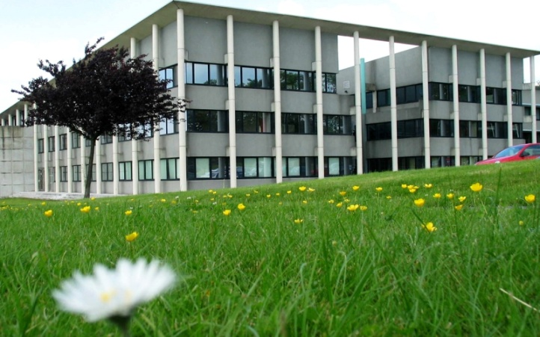
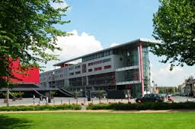
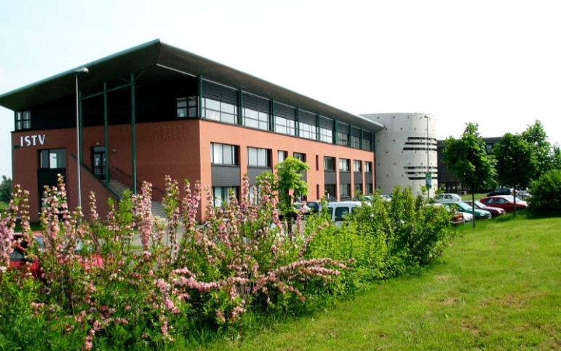
University de Valenciennes : 2 campus
Mont houy Tertiales

Slide 8
University of Valenciennes : Facts and figures
4 campus : Cambrai, Valenciennes (2 campus) and Maubeuge
More than 10 000 students, with more 1000 interntional students
8 faculties, 195 doctorates , 5 libaries
750 professional guests speakers
4 university restaurants
Sport facilities : 2 gynasiums , 1 dance hall, 1 room for material art,1 weights room and 1 stadium
50 student association

Slide 9
Thanks for you attention
Do you have any questions ?
Join us in our facebook page : licensecaivalenciennes

