Slide 1
Duale Hochschule Baden-Württemberg Mosbach
Baden-Wuerttemberg Cooperative State University Mosbach
Notes:
Selfintroduction
Outline

Slide 2
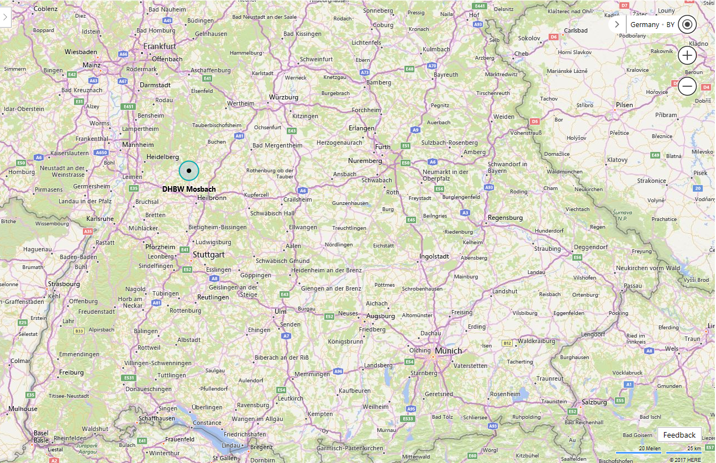

Slide 3
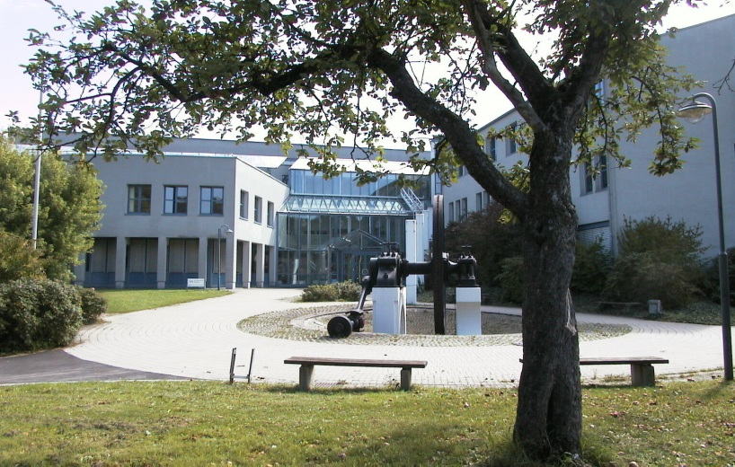
Mosbach Campus

Slide 4
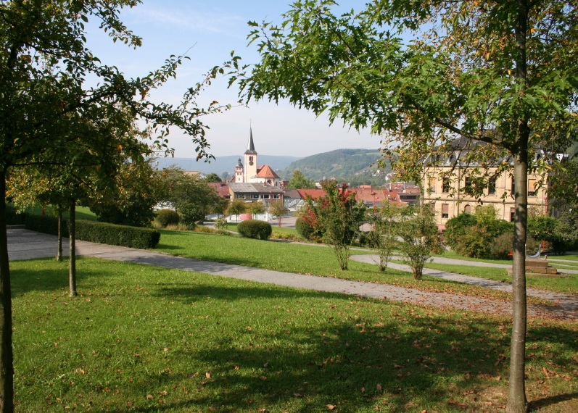
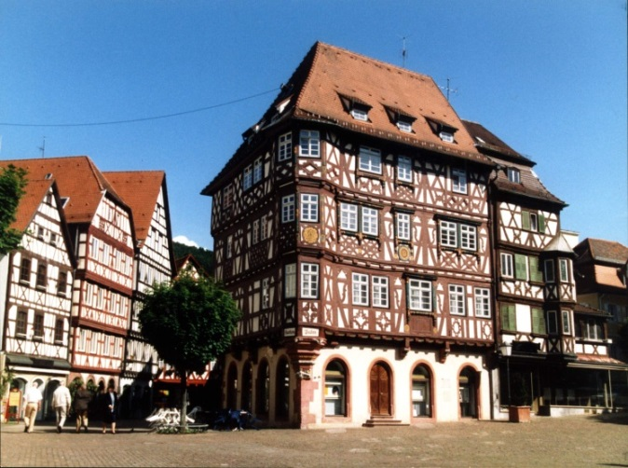
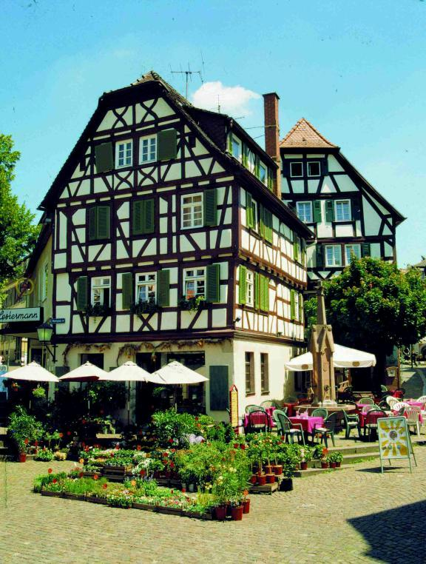
The Town of Mosbach

Slide 6
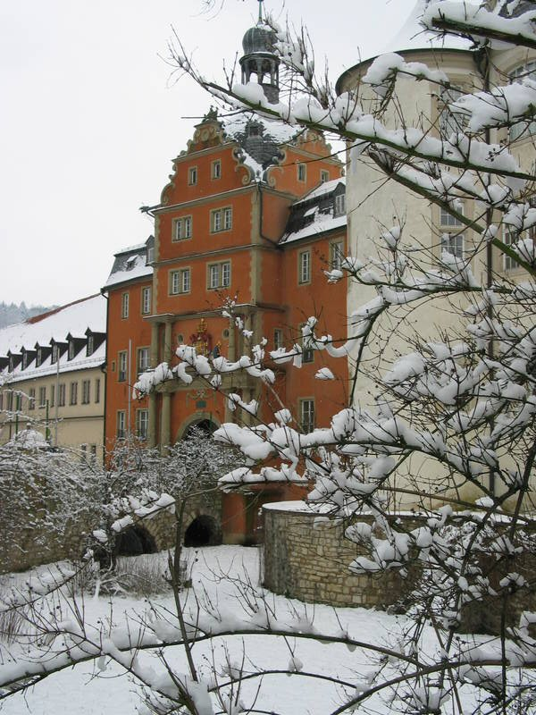
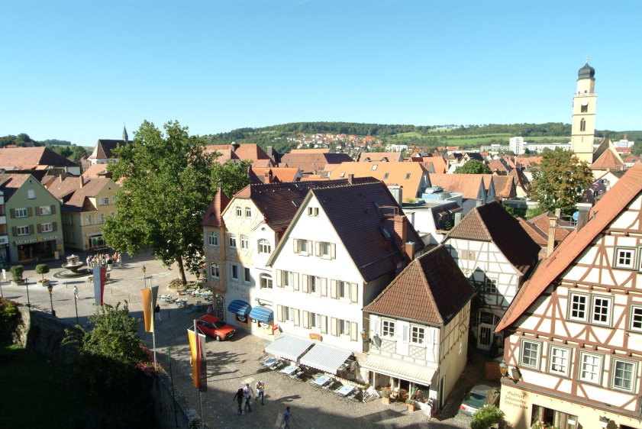
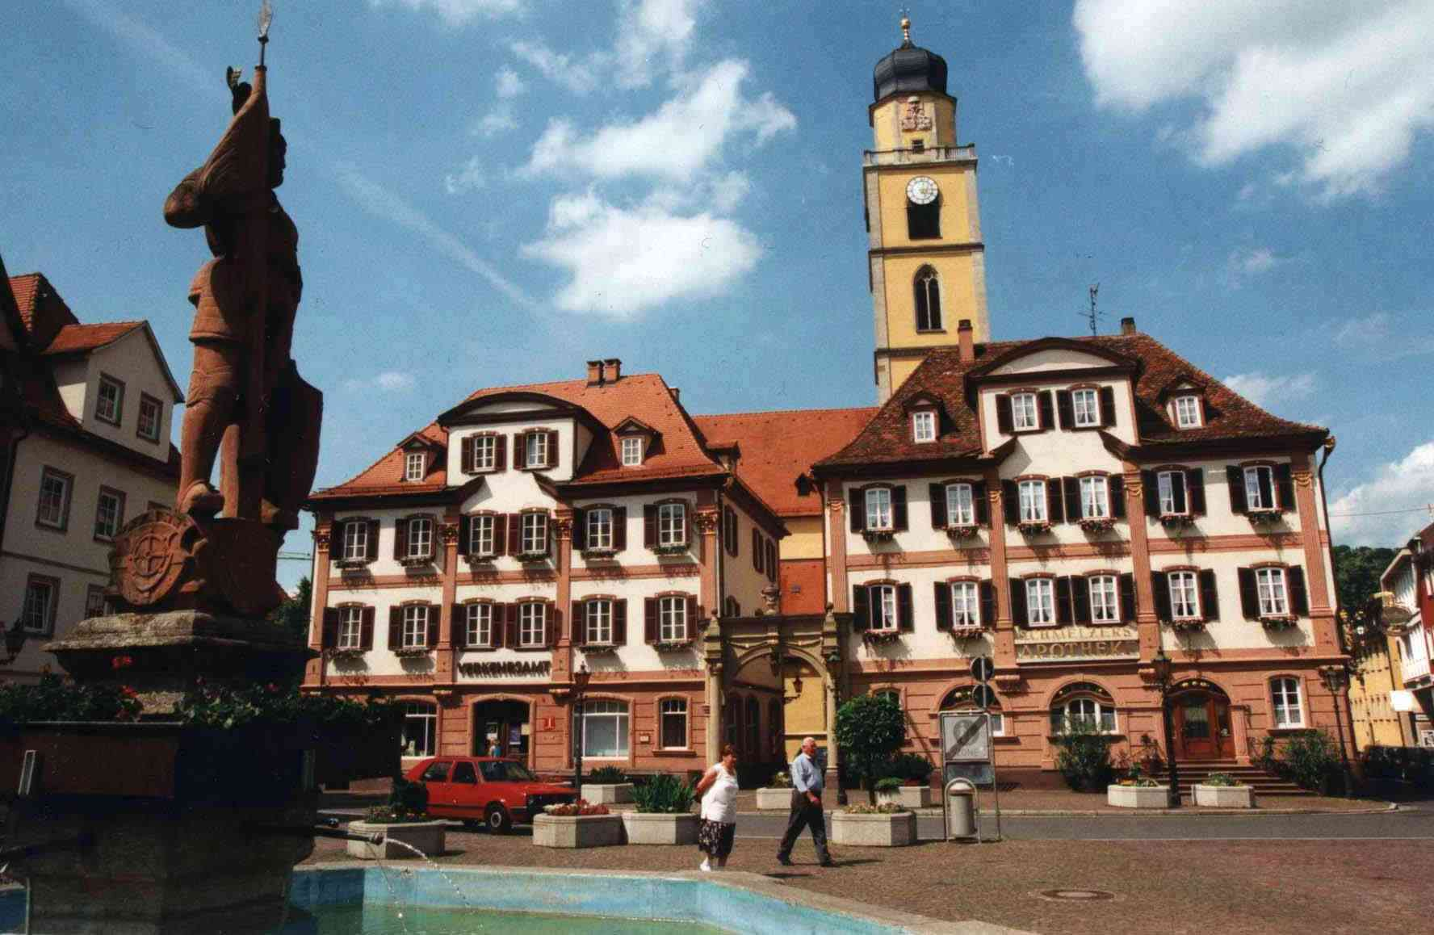
The Town of Bad Mergentheim

Slide 7
International Program in Business – Requirements for students
Level of study : | Undergraduate studies Minimum third or fourth semester
Field of study : | Business
Profound knowledge : | Economics Business administration Statistics English (at least B2)
Basic knowledge : | Mathematics Marketing Accounting Tax law

Slide 8
DHBW Mosbach International Program in Business (IPB) –Calendar and Courses
Spring March to June
Spring January to April
Fall Sep-tember to Decem-ber
Fall Semester
Financing & Investment
Accounting/Tax
Global Marketing: Product Mix, communication, E-Commerce
Macroeconomics
Leadership
Research/ Scientific Methods
Supply Chain Management
Business & Corporation Law
Intercult. & Social Skills
German Language Training
(Heidelberg)
Start: 04 September 2017
Orientation & Business Courses in Mosbach
End: 10 December 2017
Application date:
30 May 2017
Spring Semester
Organizational Behavior/Chg.
Human Resources
Operations Research
Quantitative Market Research
Direct Cost Accounting
Indus. Marketing
Negotiation
Money and Currency
Business Law
Project Management
Intercultural & Social Skills
Start: 08 January 2018
Orientation & German Language
(Heidelberg)
End: 08 April 2017
Business Courses in Mosbach
Orientation & German Language in Bad Mergentheim
Spring Semester
Organization
HRM
Intercultural Mgmt
or Change Mgmt.
International Marketing
International Finance Macroeconomics Money & Currency
Application date:
30 September 2017
Start: 28 March 2018
Business Courses
in Bad Mergentheim
End: 29 June 2018
Application date:
30 November 2017
Campus Mosbach
Campus Bad Mergentheim

Slide 9
Things to know about the International Program in Business (IPB)
Key features:
Coursework focused on the field of International Business Administration
Classes taught entirely in English
Modules in one- or two-week blocks
Intensive German language course prior to Business classes
Intercultural mix of students in class
Orientation program
Excursions
Max. 30 ECTS credits per semester
9

Slide 10
IPE – Requirements for students
Level of study : | Undergraduate studies Minimum fourth or fifth semester
Field of study : | Engineering
Profound knowledge : | Mathematics Physics General technical modules
Basic knowledge : | Electricial engineering Measurement engineering Information technology Programming (at least one programming language)

Slide 11
New offer launched in 2015: International Program in Engineering (IPE)
Modules | ECTS per module | Teaching and learning contents
A.) Automation systems engineering | 5 | A1.) Extended concepts in automation A2.) Technical information management A3.) Simulative engineering
B.) Engineering operations & business mangement | 5 | B1.) Project / process / quality management (PPQM) B2.) Business process mangamgent B3.) International business
C.) Production and information management | 5 | C1.) Business information systems in production and logistics C2.) Advanced concepts in production management C3.) Interdisciplinary seminar & lab Practice
D.) Embedded Systems | 5 | D1.) Basics and advanced concepts D2.) Architecture D3.) Lab practice: embedded systems seminar
E.) Student Research Project | 5 | Individual student research project
F.) Social and non-technical skills | 5 | F1.) Intensive German language course F2.) Additional intercultural lectures F3.) social programs, excursions & Trips
In total | 30

Slide 12
Things to know about the International Program in Engineering (IPE)
Key features:
Interdisciplinary Engineering coursework + Student Research Project (mid-April – early July)
Classes taught entirely in English
Modules in one- or two-week blocks
Intensive German language course prior to Engineering classes (late March – mid-April)
Intercultural mix of students in class
Orientation program
Excursions
Max. 30 ECTS credits per semester
12

Slide 13
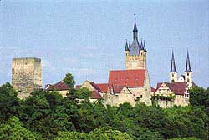
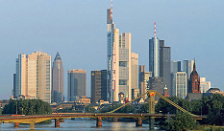
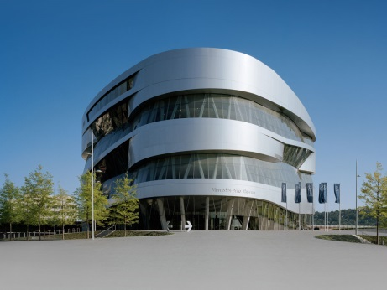
Major Highlights in the region
Bad Wimpfen
Frankfurt
Technical Museum in Sinsheim
Heidelberg
Würzburg
Stuttgart
Castle Guttenberg
Mannheim
Rothenburg ob der Tauber
13

Slide 14
Monthly charge
 | Incoming money | Costs
ERASMUS+ | +450 €
Parents, job, etc. | +200,50 € to +270,50 €
Flat rental fee |  | -190 € to -260 €
Nutrition |  | -160,50 €
Teaching material |  | -34 €
Public Transport |  | -82 €
Health insurance, doctor, medicaments |  | -29,50 €
Communication |  | -36,50 €
Freetime, culture, sport |  | -64 €
Dues |  | -54 €
Sum | 1000 € | 750 € - 800 €
Weekend visit to an other city?
150 €
Club-Party?
50-70 €

Slide 15
How to contact us – International Office
International Office in Mosbach: International Office in Bad Mergentheim:
DHBW Mosbach DHBW Mosbach, Campus Bad Mergentheim
Lohrtalweg 10 Schloss 2
D-74821 Mosbach D-97980 Bad Mergentheim
Phone +49 (0) 6261 – 939 289 Phone +49 (0) 7931 – 530 652
Fax +49 (0) 6261 – 939 514 Fax +49 (0) 6261 – 939 514
Central e-mail contact: international@mosbach.dhbw.de
Website:
http://international.mosbach.dhbw.de
IPB: www.mosbach.dhbw.de/international-program-in-business.html
IPE: www.mosbach.dhbw.de/international-program-in-engineering.html

Slide 16
Thank you very much for your attention!
Any questions?

