Slide 1
INTRODUCING AIESEC
Notes:
You can put the name of the event here also or just „welcome to the presentation”.

Slide 2
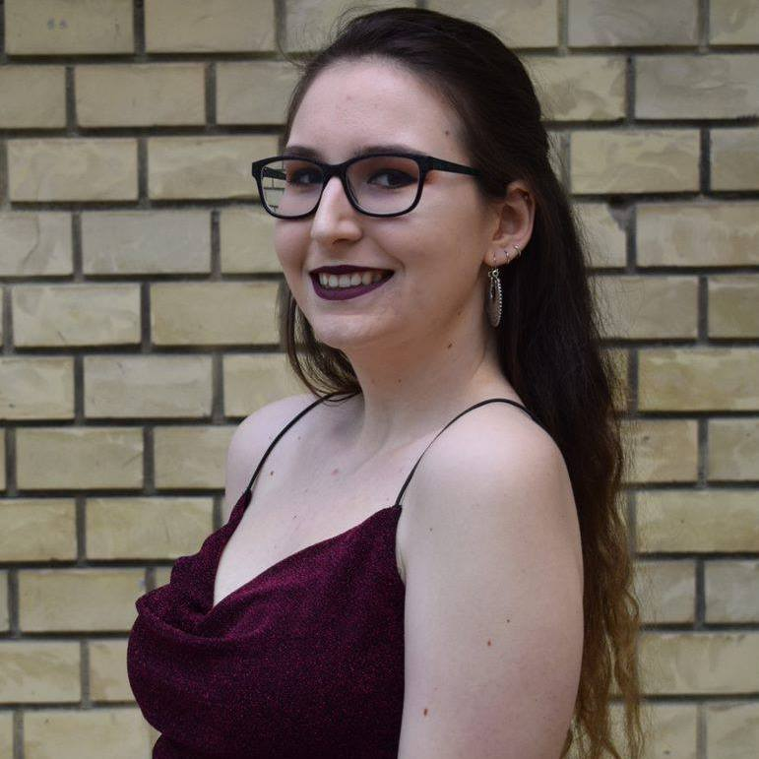
YOUR
PRSENTER
Míra
President
AIESEC in SZIE
Notes:
Put your name and position that can be translated to externaals so no e.g. LCVP OGX rather Vice President of Outgoing Customer Experience

Slide 3
WHAT IS AIESEC?
What
How
Why
Golden Circle Concept
Notes:
Explain The Golden Circle concept and why we do what we do in AIESEC and what are the opportunities for customers. Talking about the opportunities you already need to be targted and mention GV, GT or membership based on your audiance

Slide 4
OUR PROGRAMS
Notes:
Based on your audiance talk about the programs and when you talk about GT find the sub-products that is relevant for your audinca (exampla: IT student, don’t talk about teaching Enhlish in Vietnam, just about Germany, The Netherlands and so on. Or Human studies, you can talk about teaching opportunities in Turkey for exampe)

Slide 5
www.aiesec.org
Notes:
Introduce GV shortly (align how you do it based on the buyer personas) and go for the information slide

Slide 6
Opportunities
When?
Where?
Benefits
Fee
Teaching, Environmental help, Animal Care, Working in NGOs.
Winter or Summer
Italy, Turkey, Czech Republic, Poland, Indonesia
Accommodation, Food, AIESEC support, 15% insurance discount
45.000 Ft
www.aiesec.org
Notes:
To opportunities you can add anything you want based on yor audiance and based on the current opportunites at our partner countries.

Slide 7
WHAT ARE THE SUSTAINABLE DEVELOPMENT GOALS?
Notes:
Introduce the SDGs by telling that all the GV opportunities are aimin to fight for these goals. Extra info: The SDGs were found in 2015 and aims to develeop the world on the goals mentioned with hundreds of KPIs. The main measeure is the Global Social Index which was 61 average in 2015 the highest is 88 (Norway) and lowest is 31 (Central Africa) and teh aim is achieve 75 in average by 2030. (note: 61 is currently in Kazahkstan or Cuba)

Slide 8
www.aiesec.org
Notes:
Go back to GV and relate it from the SDGs and start to showcase some opportunities

Slide 9
Any questions?
Notes:
You can put the name of the event here also or just „welcome to the presentation”.

Slide 10
JOIN THE COMMUNITY
bit.ly/livetheaiesecexperience
FOLLOW US:
/AIESECinHungary
/aiesecinhungary

Slide 11
experience
with aiesec

